Slide 1



HONORHEALTH DIRECT-TO-EMPLOYER PLAN
November 27, 2024

Slide 2



Founded in 1979 and headquartered in Indianapolis, IN​
Full-service TPA specializing in the administration of self-funded health plans and population health management​
One of the country’s largest independently-owned TPAs
The Key Family is a commonly-held group of benefits related organizations with:​
3,000+ corporate clients​
3.0 million members under management​
700 Employees
Exclusive Relationships
We know The Market – Agents, Networks, and MGAs

Slide 3


Market Leader in Private Labeled DTE Plans
Louisville, KY
OneHealth Plan
Cincinnati, OH
TCH Optimal
Bentonville, AR
Northwest Health Plan
Knoxville, TN
East Tennessee Health Plan
Meridian, MS
Affinity Health Plan
Fort Myers, FL
Lee Health Care Partners

Slide 4
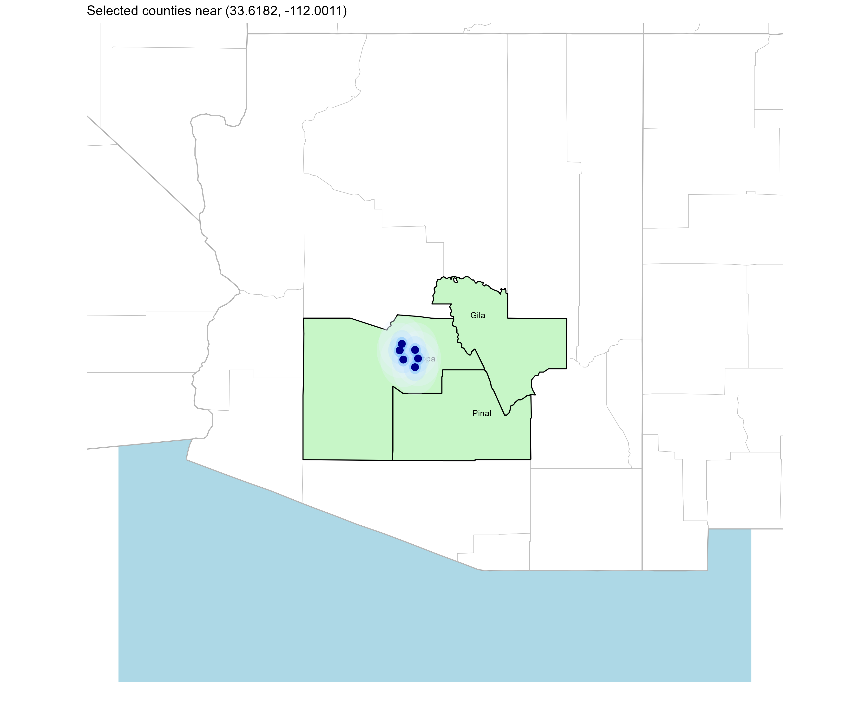
Significant Opportunity for Plan Growth Researched for Maricopa, Pinal and Gila Counties
Target Market 5,000+ Employers 700,000+ Employees 1,200,000+ Members
 | Employer Size Group (# of Employees)
Commercial Employers With Headquarters | 50-100 | 101-200 | 201-400 | 401-1,000 | 1,001-3,000 | 3,000+
In Catchment Area | 3,524 | 1387 | 876 | 502 | 151 | 116
Total Employees at Employers | 50-100 | 101-200 | 201-400 | 401-1,000 | 1,001-3,000 | 3,000+
Headquartered in Catchment Area | 264,300 | 208,100 | 262,800 | 351,400 | 302,000 | 696,000
Total Members with Employers | 50-100 | 101-200 | 201-400 | 401-1,000 | 1,001-3,000 | 3,000+
Headquartered in Catchment Area | 475,700 | 374,600 | 473,000 | 632,500 | 543,600 | 1,252,800

Slide 5
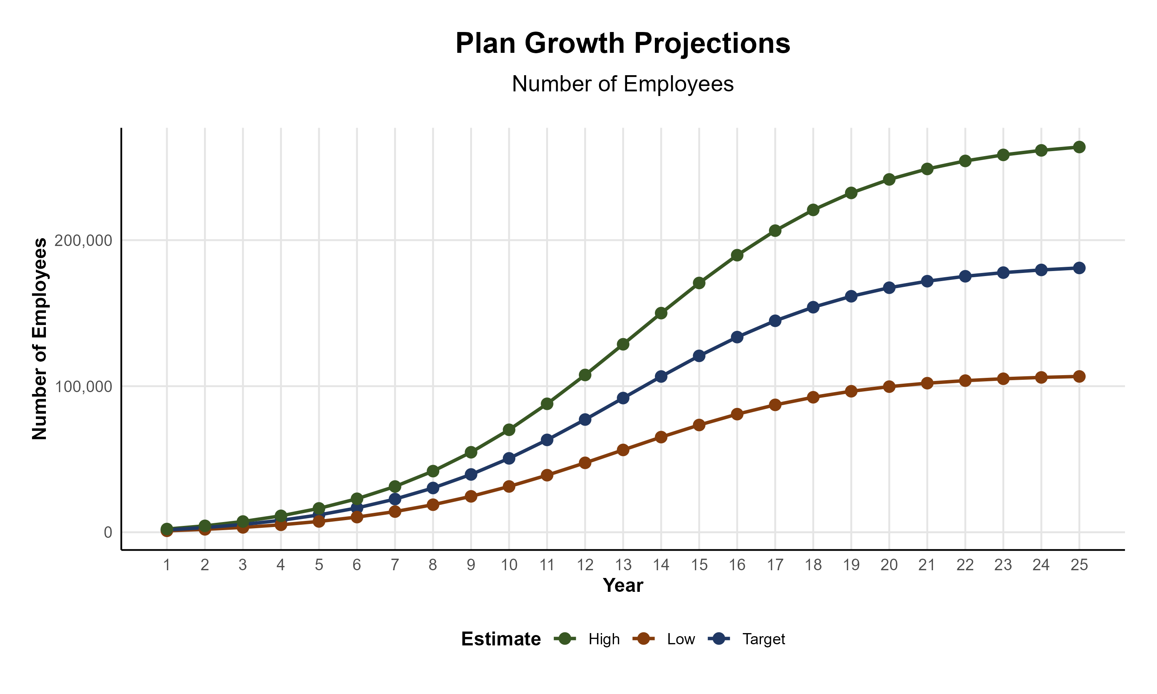
Plan Potential Growth Paths
Self Funded
1,200K
PLAN GROWTH POTENTIAL
1,935K
Insured
Working Age
2,875K
Population
4,918K
Estimates include Gila, Maricopa, and Pinal Counties

Slide 6

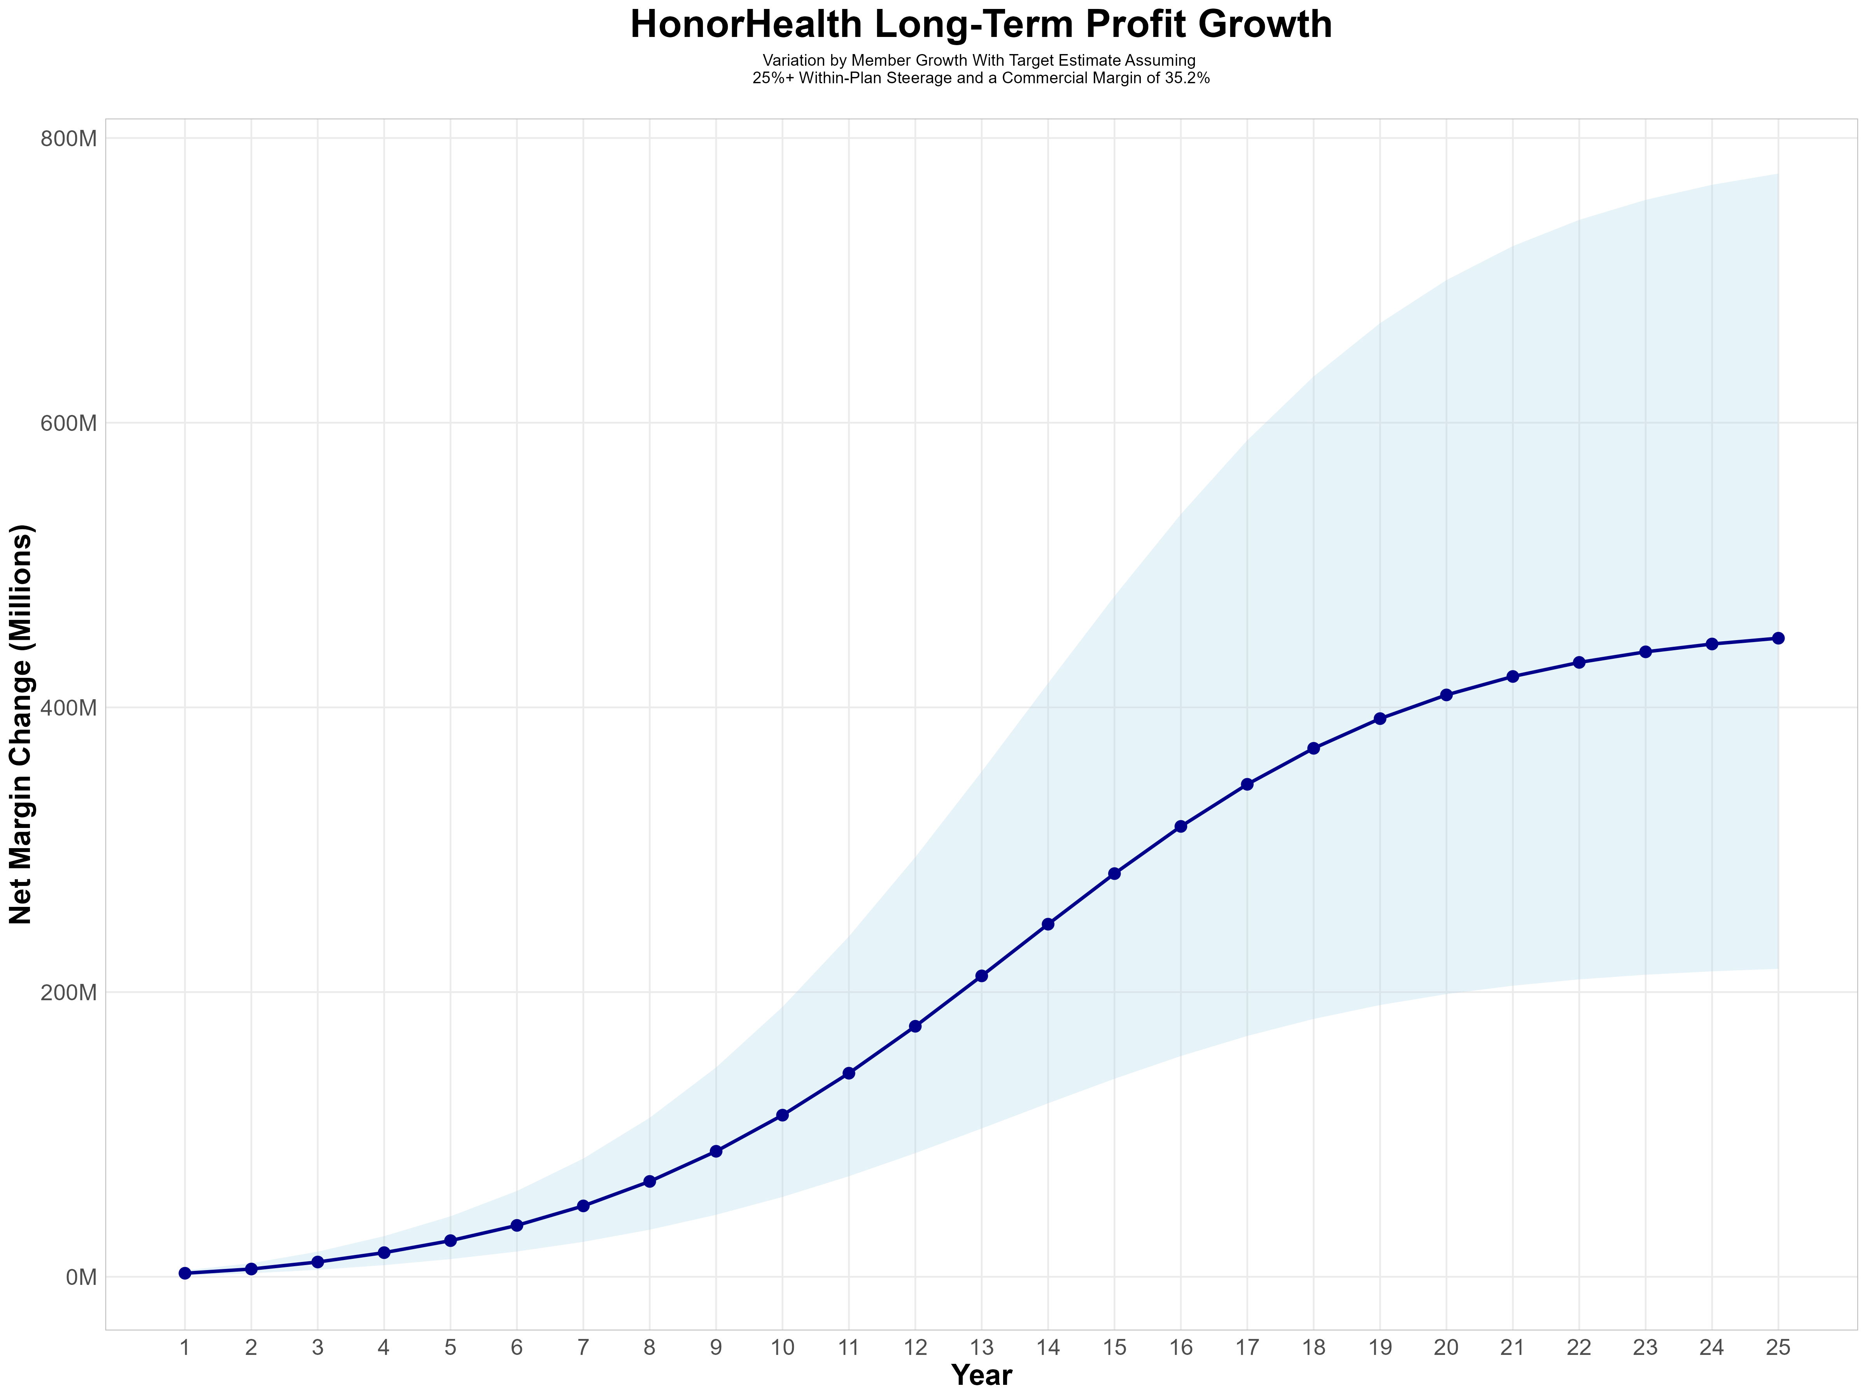
Growing Powerful, Lasting Profitability
Early Stage
Gaining Name Recognition, Early Growth
New Revenue:
New Profit:
$75.56M
$26.7M
Growth Stage
Strong Reputation, Strong Growth
New Revenue:
New Profit:
$555.58M
$197.43M
Mature Stage
High Profitability, Market Saturation
New Revenue:
New Profit:
$1158.14M
$411.52M

Slide 7
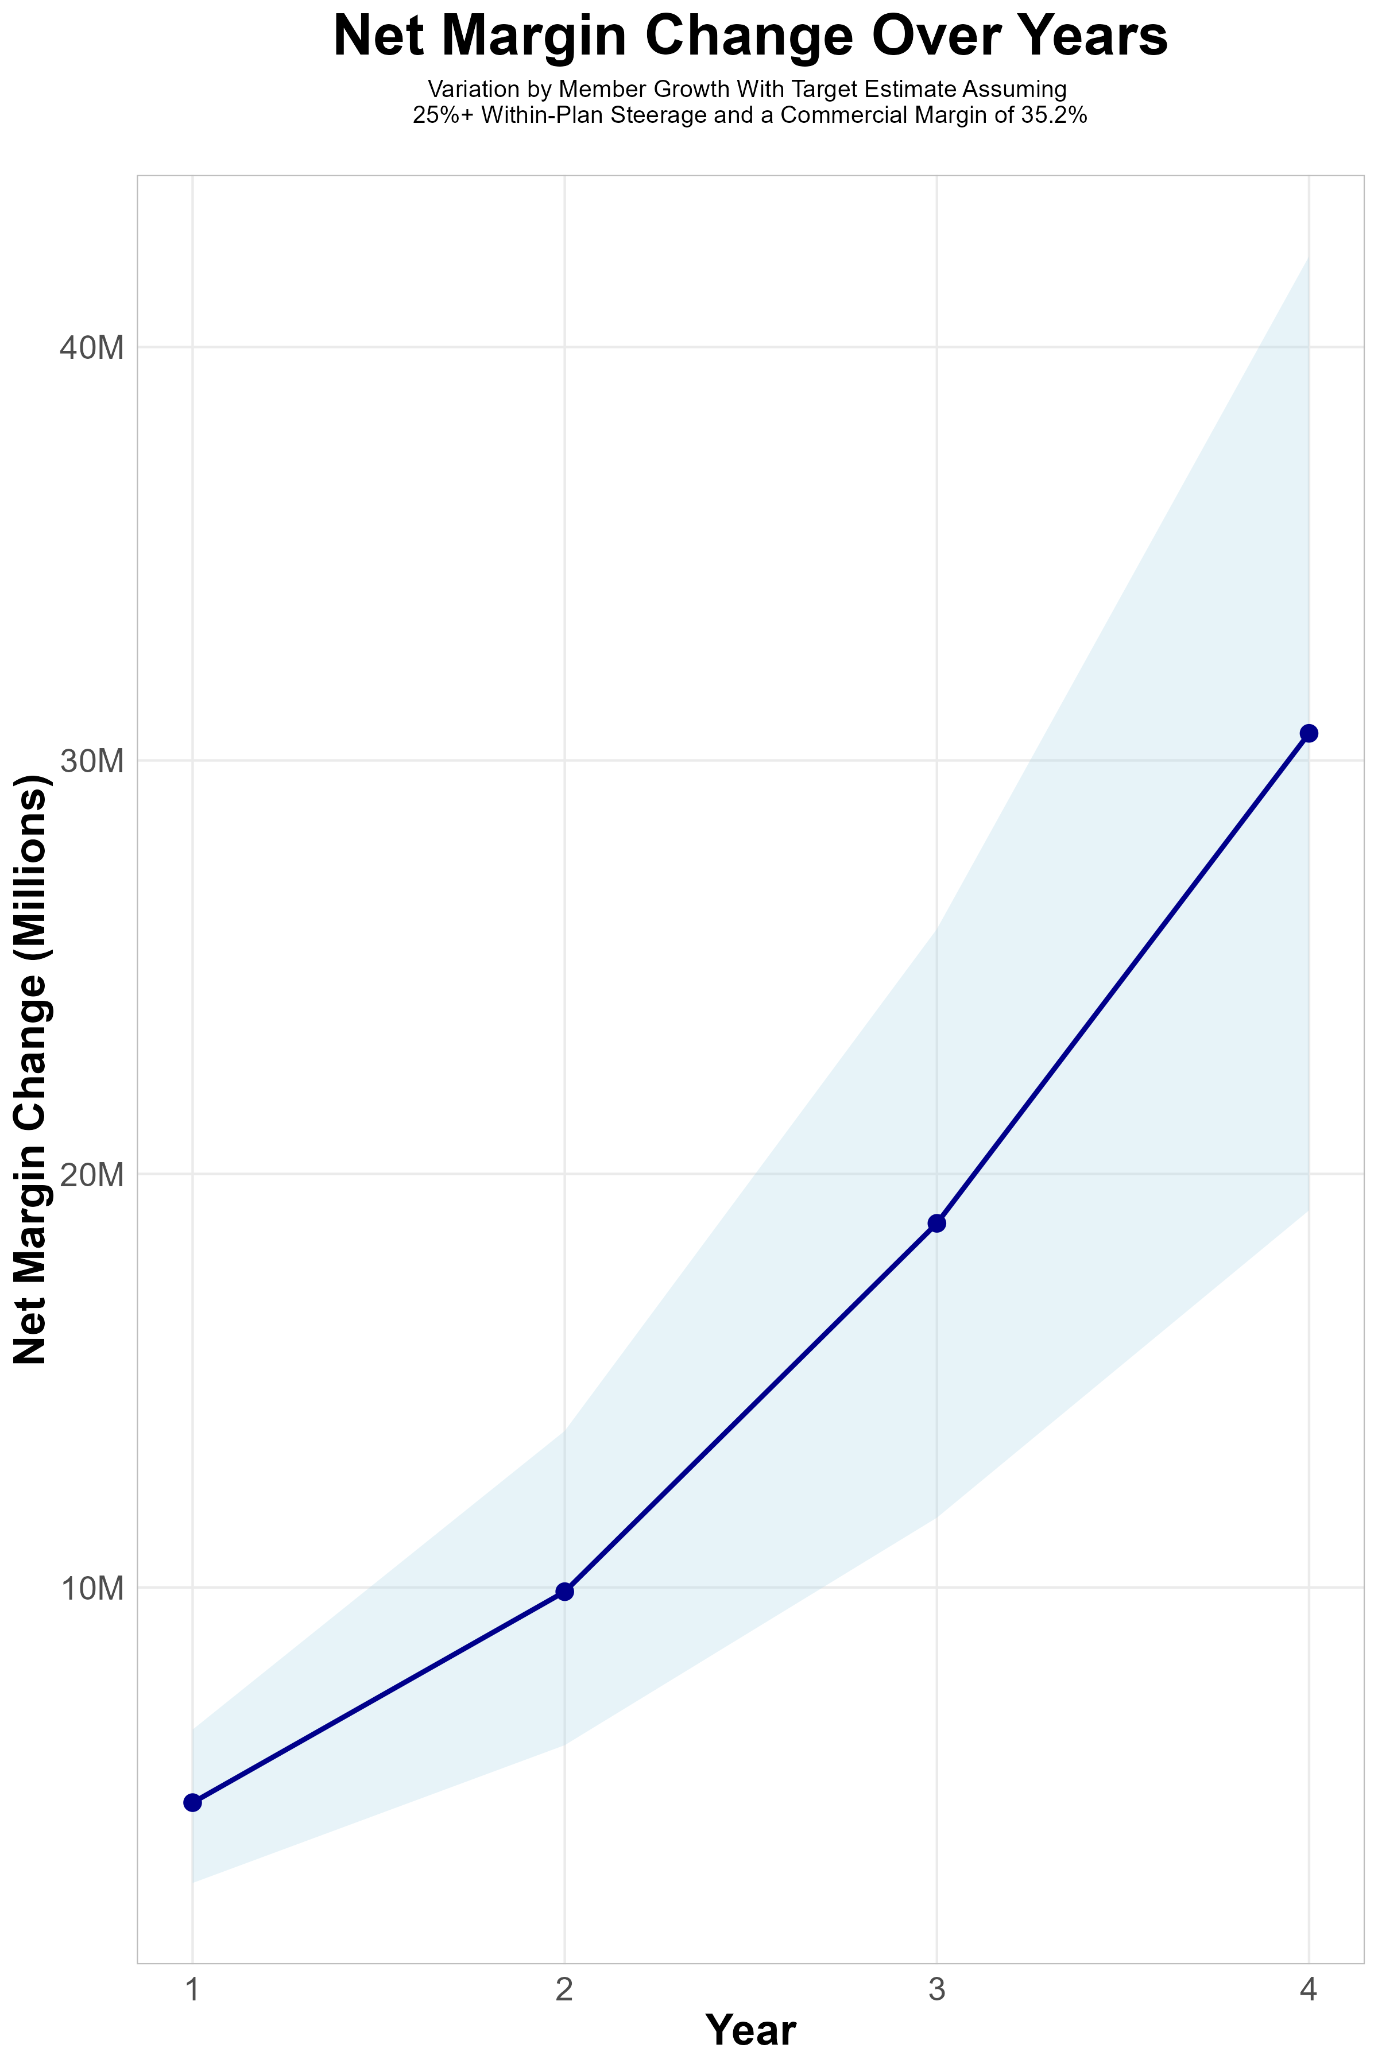
FOUR-YEAR PROJECTIONS
Target Member Growth | Target Member Growth | Target Member Growth | Target Member Growth | Target Member Growth
Metric | Year 1 | Year 2 | Year 3 | Year 4
Number of Members | 2,900 | 5,700 | 9,600 | 14,700
Incremental Margin | 5,089.8K | 10,008.2K | 18,870.3K | 30,660.1K
Network Access Fee | 34.8K | 68.4K | 115.2K | 176.4K
Implementation Fee (One-Time) | -150.0K | 0.0K | 0.0K | 0.0K
Sales and Marketing Costs | -180.0K | -180.0K | -180.0K | -180.0K
Net Margin Change | 4,794.6K | 9,896.6K | 18,805.5K | 30,656.5K
Variation by Member Growth With Target Estimate Assuming
50%+ Within-Plan Steerage and a Commercial Margin of 35.2%
High Member Growth | High Member Growth | High Member Growth | High Member Growth | High Member Growth
Metric | Year 1 | Year 2 | Year 3 | Year 4
Number of Members | 3,900 | 7,900 | 13,200 | 20,200
Incremental Margin | 6,844.9K | 13,871.0K | 25,946.6K | 42,131.5K
Network Access Fee | 46.8K | 94.8K | 158.4K | 242.4K
Implementation Fee (One-Time) | -150.0K | 0.0K | 0.0K | 0.0K
Sales and Marketing Costs | -180.0K | -180.0K | -180.0K | -180.0K
Net Margin Change | 6,561.7K | 13,785.8K | 25,925.0K | 42,193.9K
Low Member Growth | Low Member Growth | Low Member Growth | Low Member Growth | Low Member Growth
Metric | Year 1 | Year 2 | Year 3 | Year 4
Number of Members | 1,800 | 3,600 | 6,000 | 9,200
Incremental Margin | 3,159.2K | 6,321.0K | 11,793.9K | 19,188.6K
Network Access Fee | 21.6K | 43.2K | 72.0K | 110.4K
Implementation Fee (One-Time) | -150.0K | 0.0K | 0.0K | 0.0K
Sales and Marketing Costs | -180.0K | -180.0K | -180.0K | -180.0K
Net Margin Change | 2,850.8K | 6,184.2K | 11,685.9K | 19,119.0K

Slide 8
Direct-to-Employer Strategy: Only Available to Premier Health Systems
STRONG Brand Quality
EXTENSIVE Patient Access
AFFORDABLE Value Pricing
EXCELLENT Care Quality

Slide 9
HonorHealth is Patient Recommended
Health System | HCAHPS Recommendation Percentile | CMS Stars Percentile | Mortality Percentile | Readmission Percentile | KBA Brand Quality Score
Mayo Clinic | 99 | 100 | 81 | 78 | 78
CommonSpirit Health | 76 | 87 | 59 | 77 | 70
HonorHealth | 70 | 54 | 69 | 62 | 69
Banner Health | 34 | 54 | 72 | 65 | 57
Indian Health Service | 24 |  | 59 | 44 | 54
Valleywise Health | 21 | 31 | 71 | 46 | 52
Steward Health Care System | 11 | 24 | 57 | 67 | 48
Tenet Healthcare | 7 | 22 | 65 | 67 | 46
Based on quality measures and HCAHPS feedback, KBA estimates that HonorHealth has the strongest brand quality in Gila, Maricopa, and Pinal Counties.

Slide 10
Year 4 Projected Revenue and Profit
Pre-DTE Cohort of 14,700 Employees | Inpatient | Outpatient | Professional | Total
Revenue† | $ 9,028,466 | $ 10,122,108 | $ 4,726,938 | $ 23,877,512
Net Income‡ | $ 3,178,020 | $ 3,562,982 | $ 1,663,882 | $ 8,404,884
† Assuming proportional revenues from market shares of 18% (inpatient) and 11% (outpatient)
‡ Conservatively assuming a commercial margin of 35.2% (80% of the estimated commercial margin)
With DTE | Inpatient | Outpatient | Professional | Total
Revenue⁰ | $ 33,488,170 | $ 52,481,987 | $ 24,508,642 | $ 110,478,798
Net Income* | $ 11,787,836 | $ 18,473,659 | $ 8,627,042 | $ 38,888,537
⁰ Assuming 67% inpatient and 58% market steerage based on KBA narrow network DTE experience (see previous slide)
* Conservatively assuming a commercial margin of 35.2%, with a 10 percentage-point reduction to reflect competitive-edge rates and a 10 percentage-point increase due to lower billing costs and higher patient responsibility collections because of the member credit card.
Total Increase in Net Income | $ 30,483,653
Network Access Fee (Revenue) of $1 PMPM | $ 176,400
Total Profit Growth | $ 30,488,453
Minus Implementation Fee (One-Time) | -$ 0
Minus Sales and Marketing (Annual – Ongoing) | -$ 180,000
Total | $ 30,480,053

Slide 11





A Partner You Can Trust
OUR OBJECTIVES ARE ALIGNED
WE KNOW THE
MARKET
COMPLETELY TRANSPARENT
WE HAVE THE SOPHISTICATION AND INFRASTRUCTURE TO EFFECTIVELY COMPETE
Derek Moore, Senior Vice President – KBA
845-283-9973 * derek.moore@keybenefit.com

